Slide 1
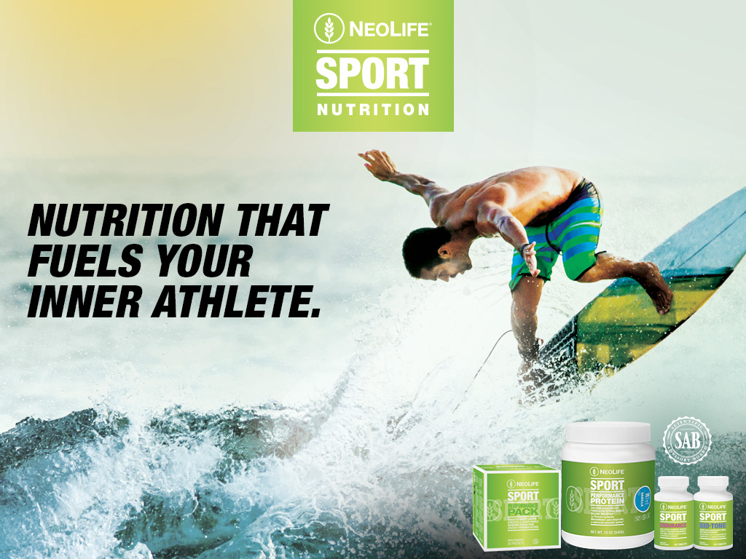

Slide 2

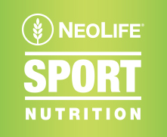
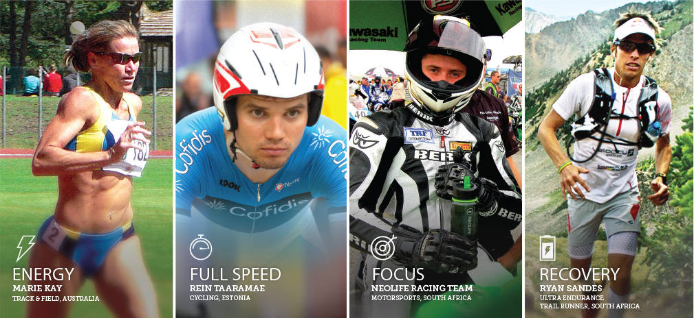
For decades NeoLife has been a trusted source of powerful nutritional supplementation for some of the world’s best athletes.
Now that is all brought together under the exclusive brand
NeoLife SPORT

Slide 3
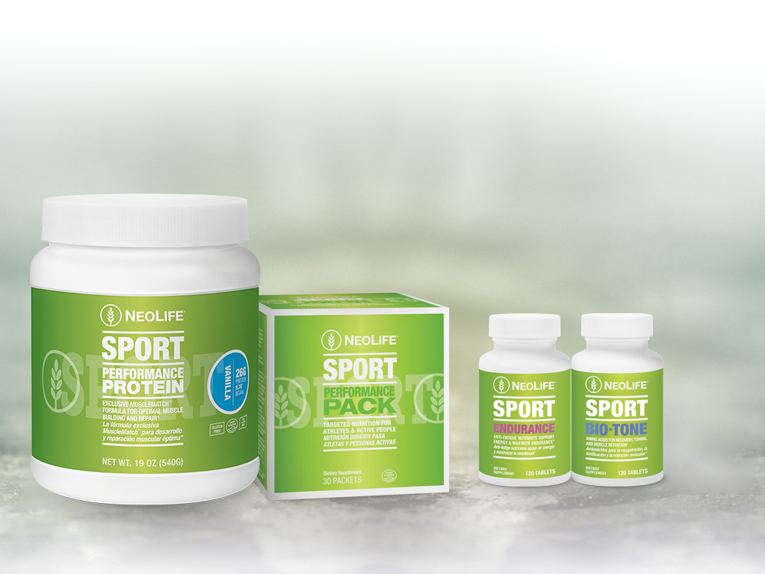


Slide 4

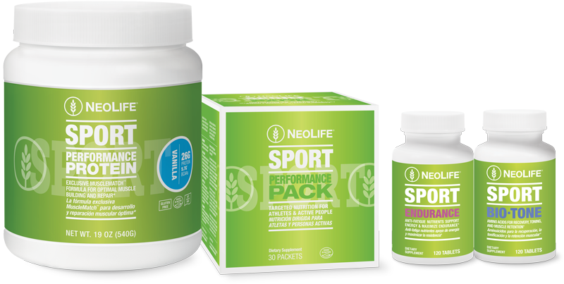
  Perfect for all 3 stages of the athletic lifestyle:
  Training • Competing • Recovering
  Complete protein and amino acid profile
  Comprehensive, broad-spectrum vitamin & mineral delivery
  Targeted support: Energy, Endurance, Recovery*

Slide 5

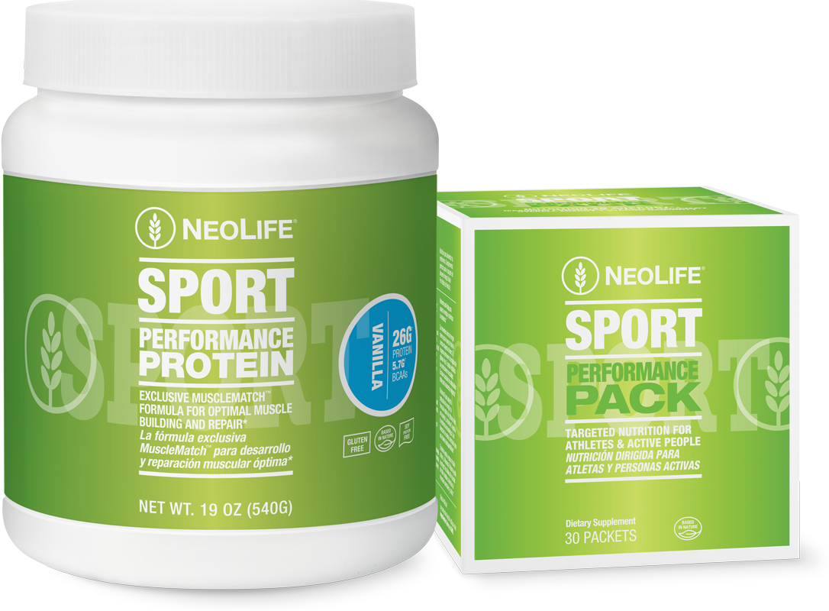
NeoLife SPORT Performance Protein and Performance Pack products work together to give your body gold medal nutrition, every day!

Slide 6
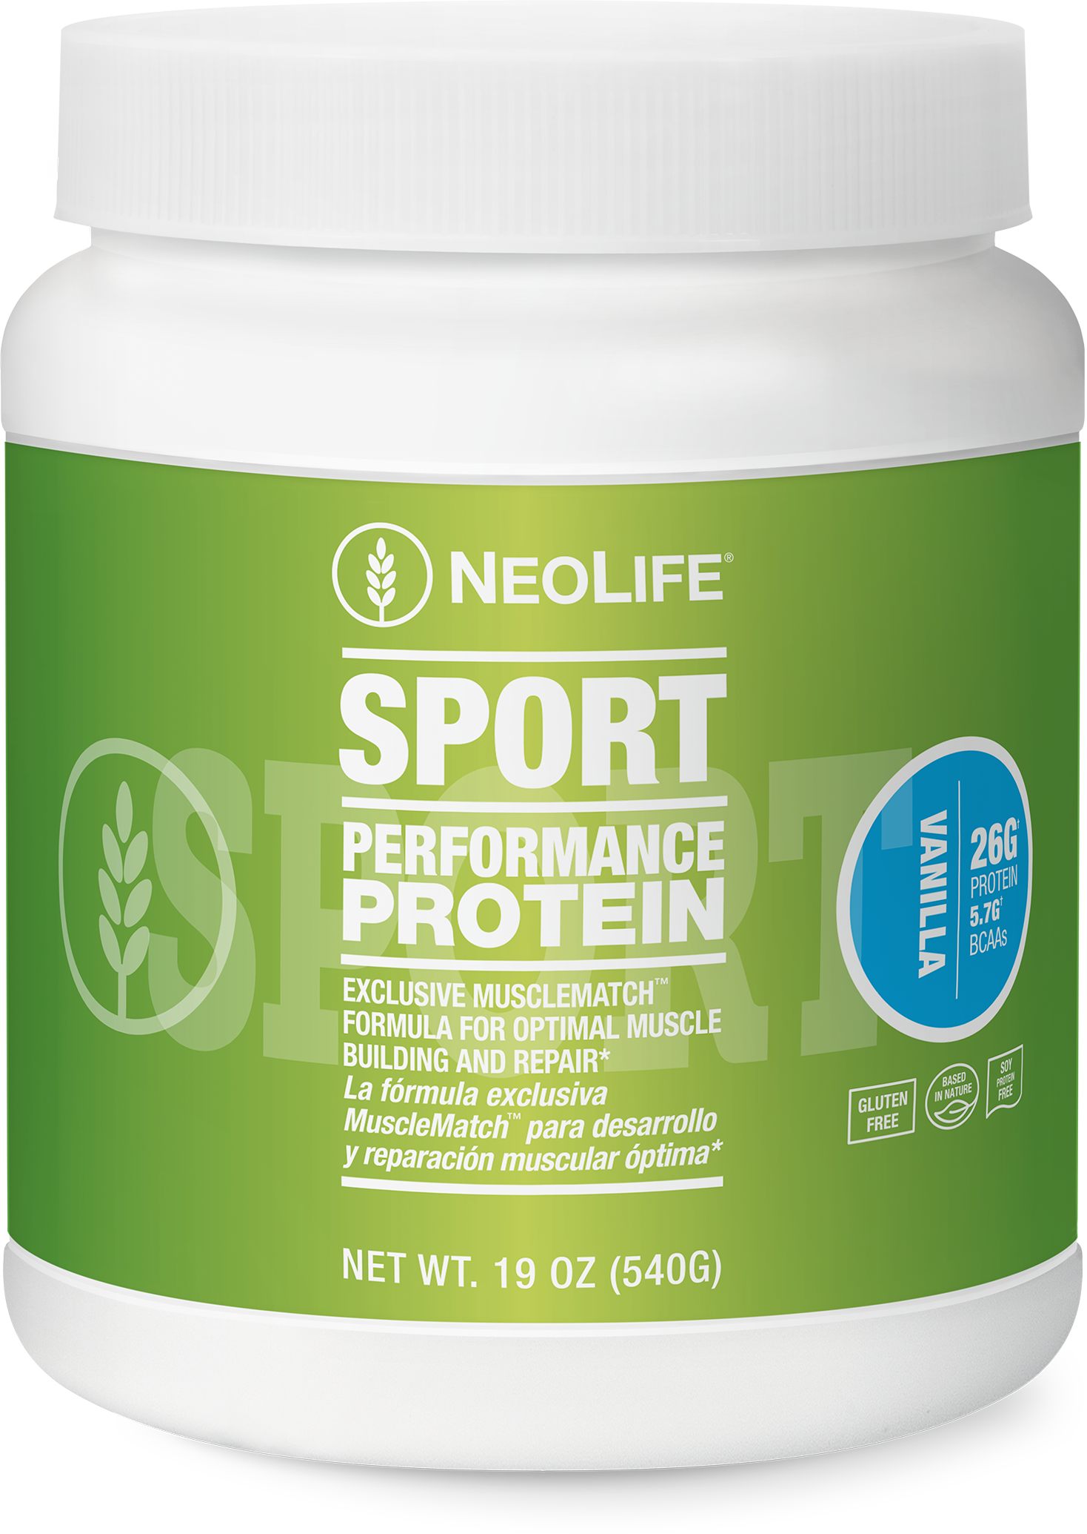



MuscleMatch™
NeoLife’s proprietary protein and amino acid complex
Each serving prepared in nonfat milk provides:
26g protein power!
5.7g of BCAA’s –
Lean tissue, muscle building
2.6g of Leucine –
Optimal muscle regeneration and retention
5.1g of Glutamine and Glutamic Acid –
Cellular metabolism, neuro-transmission,
Immune competence*

Slide 7
Biologically complete with 22 amino acids
Metabolically balanced with 25 essential vitamins, minerals and related ergogenic nutrients.
    Extra chromium and magnesium
Proprietary HoneyFruit sweetener system
Protein-sparing carbohydrates - 1:1†
Exclusive Protogard Process
Digestion-promoting enzyme blend
No artificial colors, flavors, sweeteners or preservatives added!
†mixed in nonfat milk

Slide 8
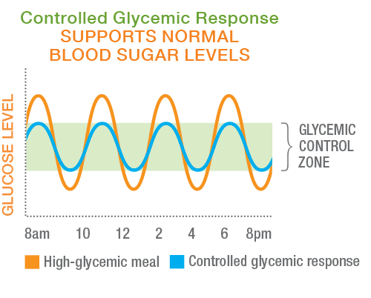
Glycemic Response Control Technology helps support normal blood sugar levels.*

Slide 9
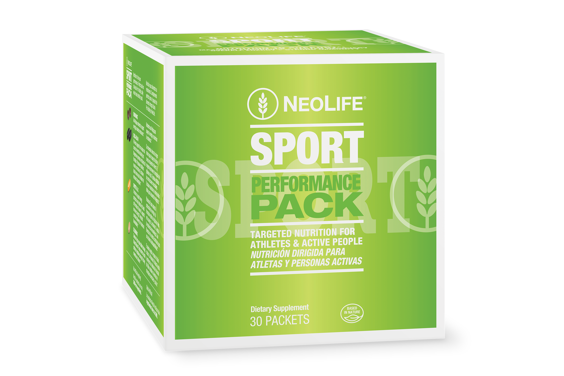
Comprehensive supplementation specifically formulated for active and athletic lifestyles!
Energy producing, fatigue-fighting, immune strengthening nutrition for longer workouts, stronger competition, faster recovery.*

Slide 10





Exclusive NeoLife formulations and technologies!
Laboratory tested & real-life proven
Each packet includes 6 tablets:
2 Endurance tablets
2 Chela-Sea M tablets
1 Sports B & C tablet
1 Selenium E tablet

Slide 11
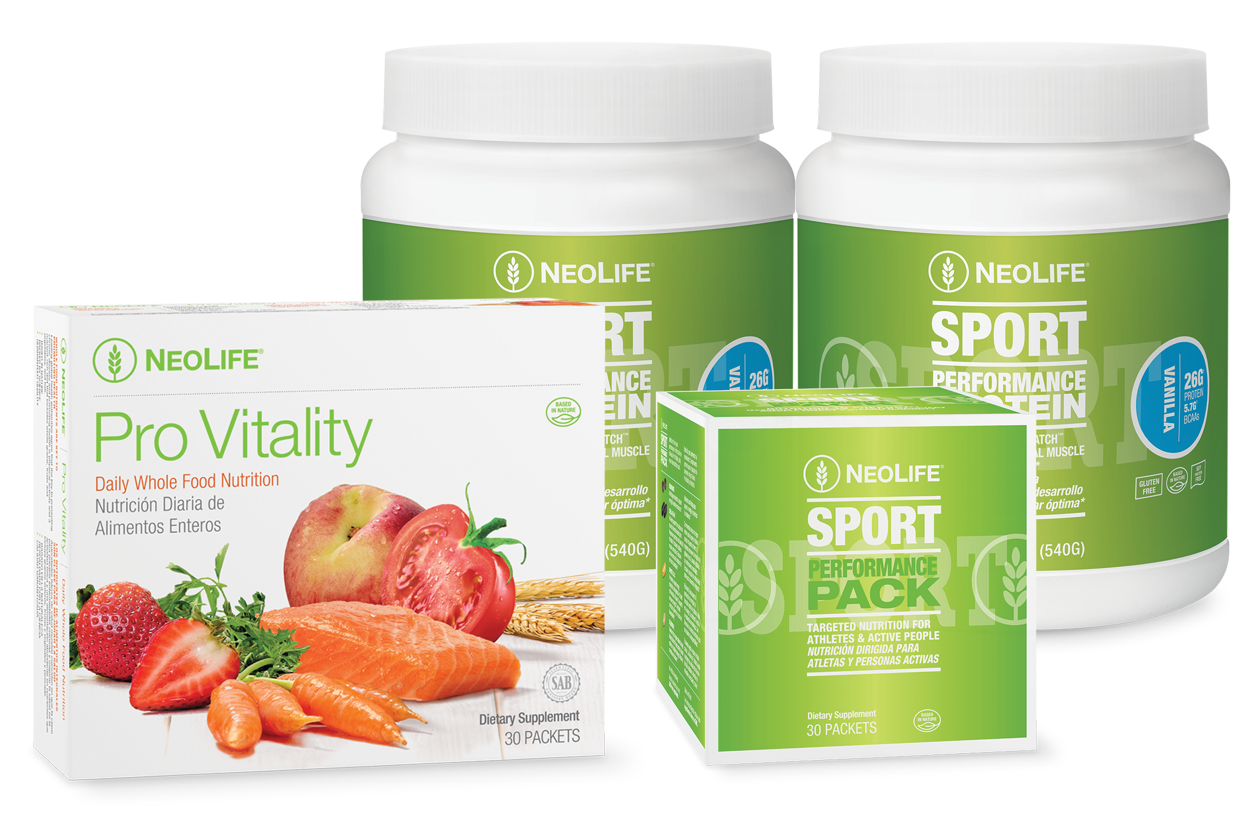
SPORT Pack
A 30-day supply of performance targeted nutrition for athletes and active people.

Slide 12



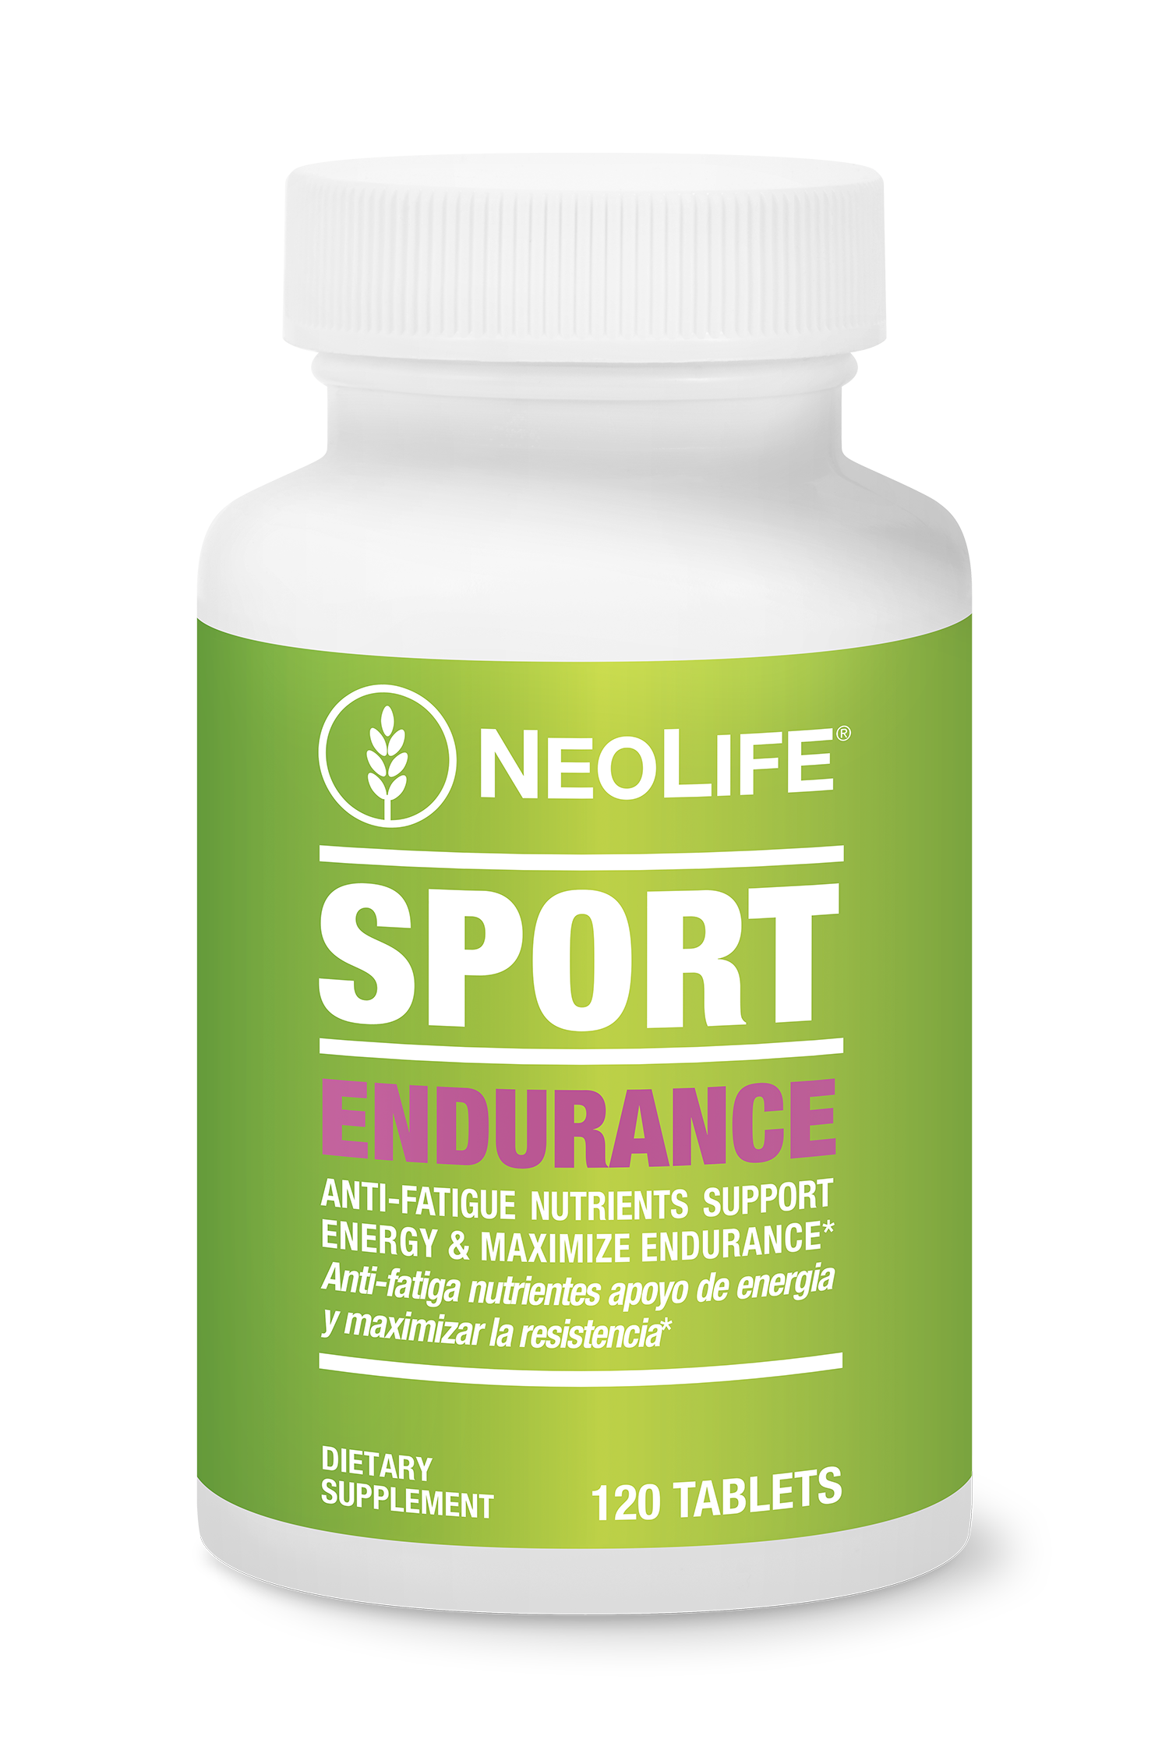
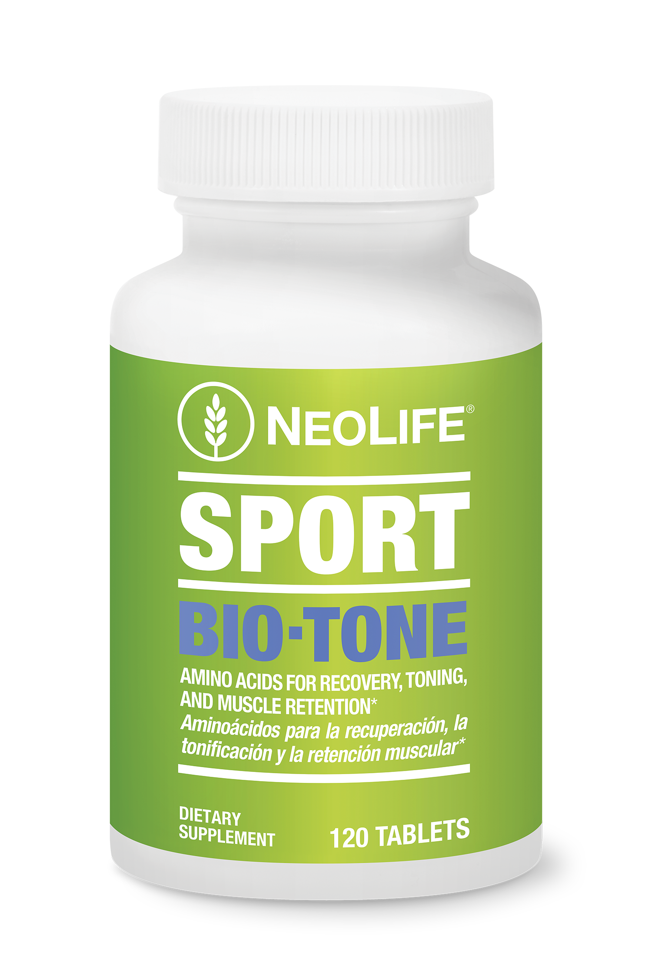

Slide 13

Superior concentrated source of natural ‘anti-fatigue’ nutrients*
Vitamin C and bioflavonoids added
Special protective coating

Slide 14

Supports muscle retention and lipid mobilization*
Designed to work while you sleep
Supports restful sleep*

Slide 15





No potentially dangerous stimulants
No artificial colors, flavors, sweeteners, or preservatives!
Guaranteed to be free of any substance currently banned by the National Collegiate Athletic Association, International Olympic Committee, and World Anti-Doping Agency

